Slide 1
Poclain PIMS – Project Flow

Slide 2
PIMS Project – Flow - users
PIMS Users :
Employee
New Suggestion,
Work in Implementation team assigned by Department Manager
Implementation team response will be sent to HOS of the Department
Data Bank Manager
Process new Suggestion to committee member
Post Suggestion for Employee
Evaluate committee response and sent to Respective Department HOD.
Get Knowledge or Information about all IDEA (Employee Suggestion)
Process Final Idea status to Finance department.
Add Employee, Credential Employee, Manager, Committee members to application

Slide 3
PIMS Project – Flow - users
PIMS Users :
Committee Member
Verify IDEA
Committee team has more than one peoples, they are evaluate IDEA, if any one of the committee member rejected IDEA then that IDEA will never go for the further step.
They can Approve or Reject IDEA
Response sent to Data Bank Manager only
HOD
Create Implementation team member with respect to IDEA and send mail to team member for project implementation.
Create Team members
Validate IDEA and check whether IDEA is feasible or not. If not feasible make that idea into hold state else go for implementation
If Respective HOD not belongs to that idea or requires any support then HOD can send request to another department HOD for project implementation.

Slide 4
PIMS Project – Flow - users
PIMS Users :
HOS
Evaluate Implementation Team based on start date and end date and also evaluate the scope of the IDEA, based on that HOS will give score to the Team members and IDEA.
After evaluation, HOS will send mail to Beneficiary Department
Beneficiary Department
Beneficiary has more than one HOS peoples
Every people in Beneficiary team will evaluate HOS score and send response to Databank manager
Finance
Check mail sent by Databank manager and process payment for the IDEA and complete status of the IDEA.

Slide 5
PIMS work flow 1
New Suggestion by Employee
Data bank manager
Data Bank Manager – send to Committee member
Committee Member’s
Approve
Reject
Data bank manager
Check Approved
Check Rejected

Slide 6
PIMS work flow 2
Data bank manager
Check Rejected
Check Approved
Update Idea to be Rejected
Sent to Respective Manager for implementation
Manager

Slide 7
PIMS work flow 3
Manager will check
Forward to another Department
Feasible
Not Feasible
Already Implemented
Create Team member for idea
IDEA – set - HOLD
Send IDEA information to Implementation team
Implementation Team

Slide 8
PIMS work flow 4
Implementation Team
Implementation Team members will accept IDEA and start implementation work
Send Response to HOD
HOD
HOD evaluate – IDEA and Implementation team effort (duration and performance) based on that HOD give score to team and Grade to IDEA
Send Response to Beneficiary Team

Slide 9
PIMS work flow 5
Beneficiary Team
Beneficiary Team evaluate score of IDEA given by HOD
they will accept or alter the Grade given by HOD
Send Response to Beneficiary Approval
Beneficiary Approval
Beneficiary Approval will check and send response to Financial Manager

Slide 10
PIMS work flow 6
Financial Manager
Financial Manager will verify both User and Implement Member given from Beneficiary Approval
based on Beneficiary Approval amount provide to employee (manual) and update status as complete
Status notified to all and IDEA completed

Slide 11
PIMS WORK FLOW SCREENSHOTS
Modules List:
Main Dashboard module
Login module
Employee module
DBM module
Committee module
HOD module
Implementation module
HOS module
Beneficiary module
Beneficiary Approval module
HR module
Finance module

Slide 12
HOME

Slide 13
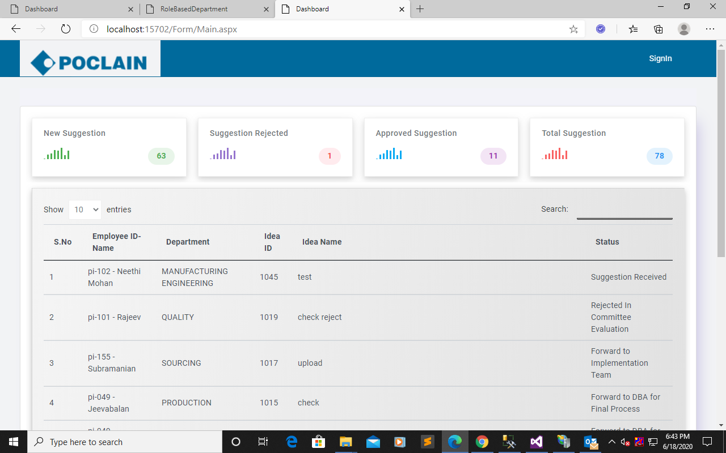
Main Dashboard module: In this module represents overall suggestions count based on total, reject, approve and new suggestion.
SIGNIN PROCESS

Slide 14
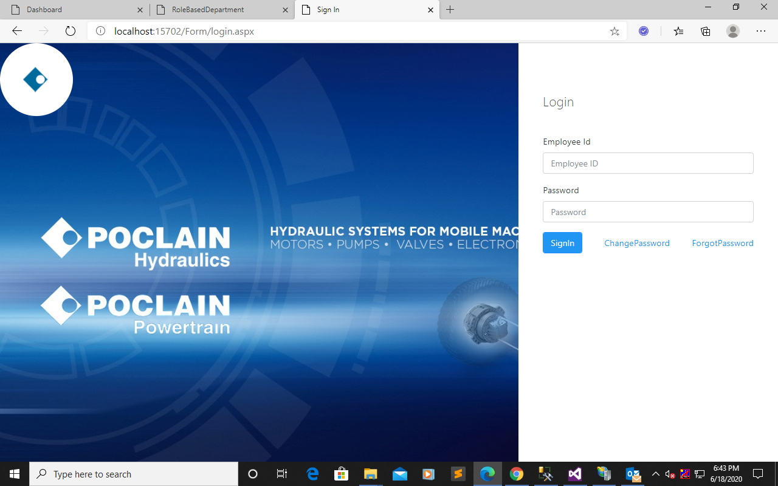
Login module: In this module represents login process for both official member and employees.
LOGIN PROCESS

Slide 15
EMPLOYEE

Slide 16
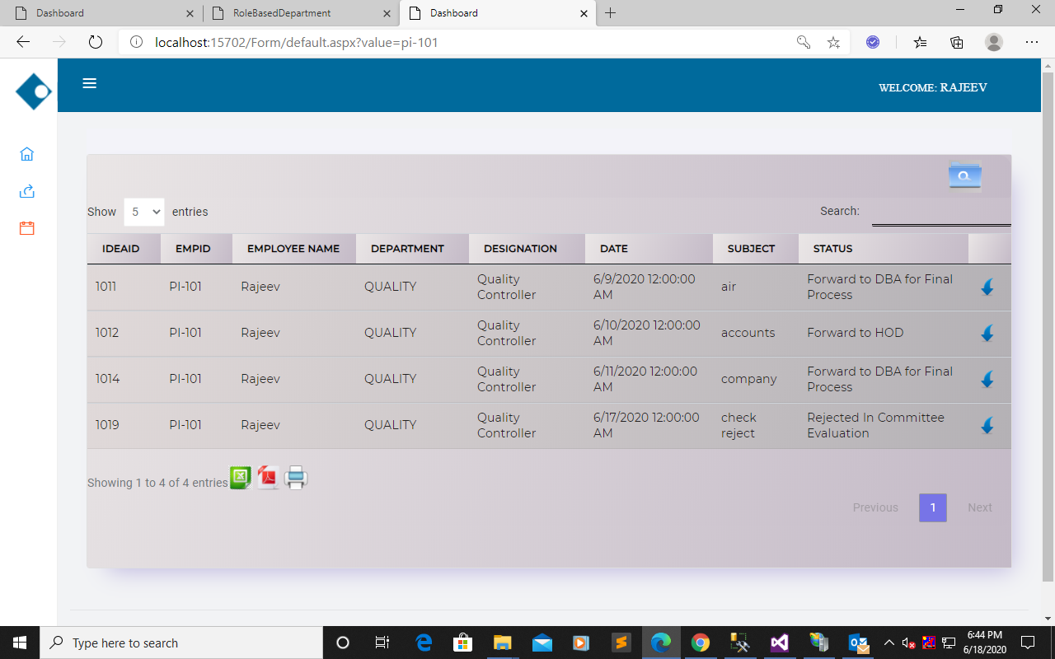
Employee module In this module contain Home, New suggestion and Employee Task, in Employee Task as Implementation module defined. Home: Contains idea list view based on employee.
IDEA LIST

Slide 17
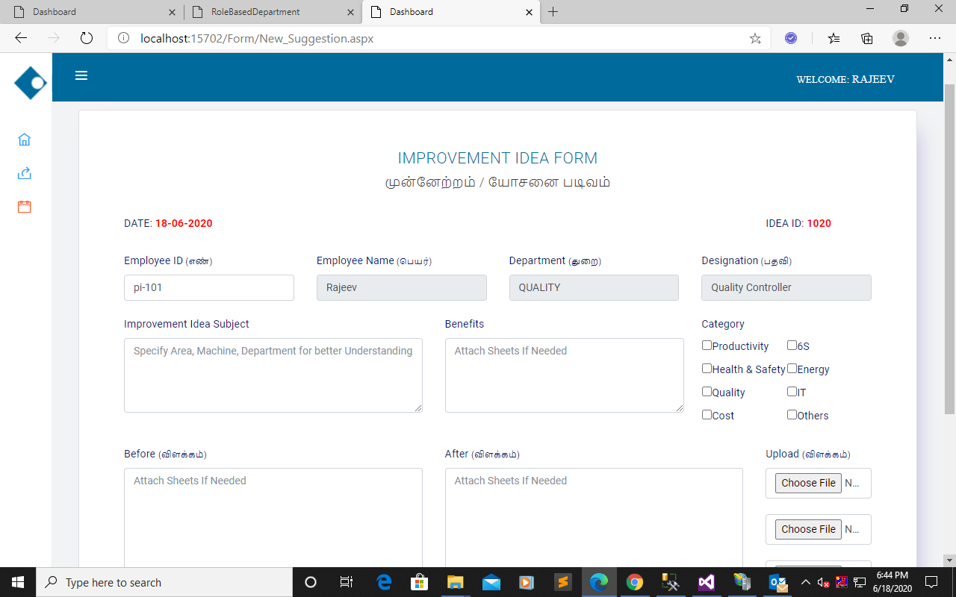
New Suggestion: Employee will suggestion post here
NEW SUGGESTION
PROCESS

Slide 18
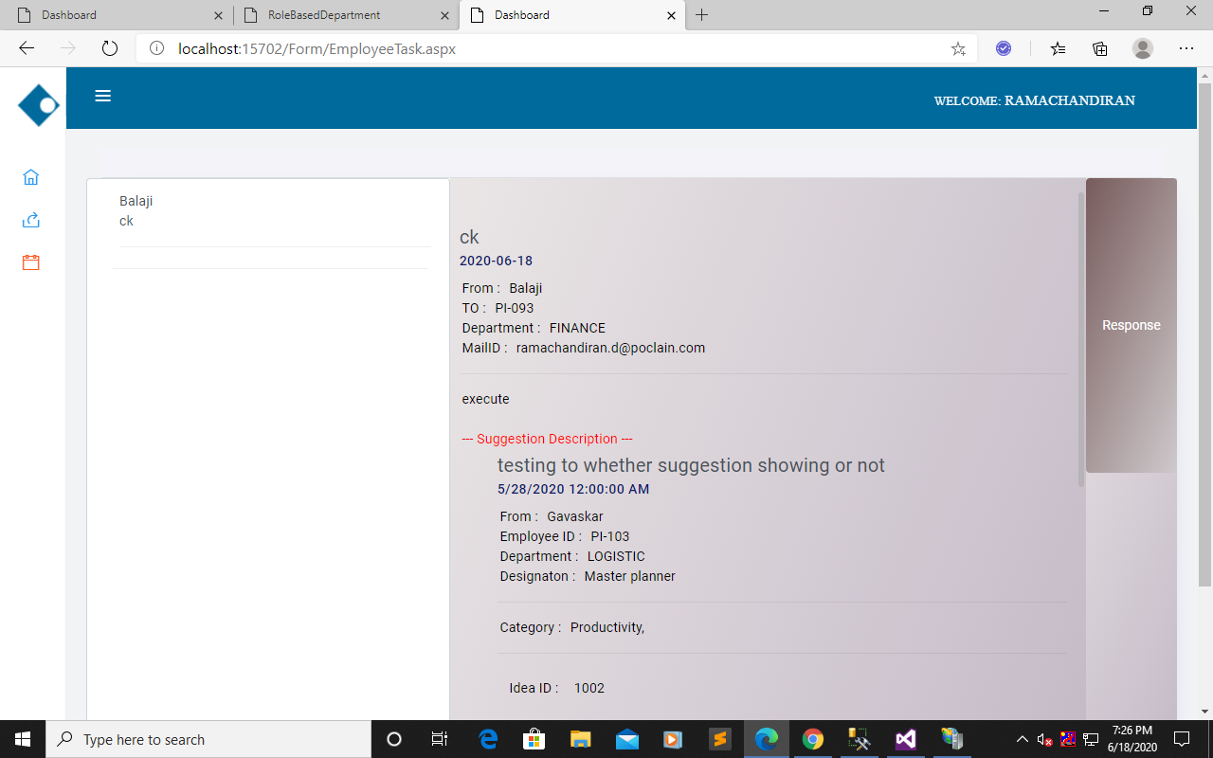
Implementation module:(Task) In this module represent HOD assign task to Team member(Employee).
MAIL BOX
CLICK

Slide 19
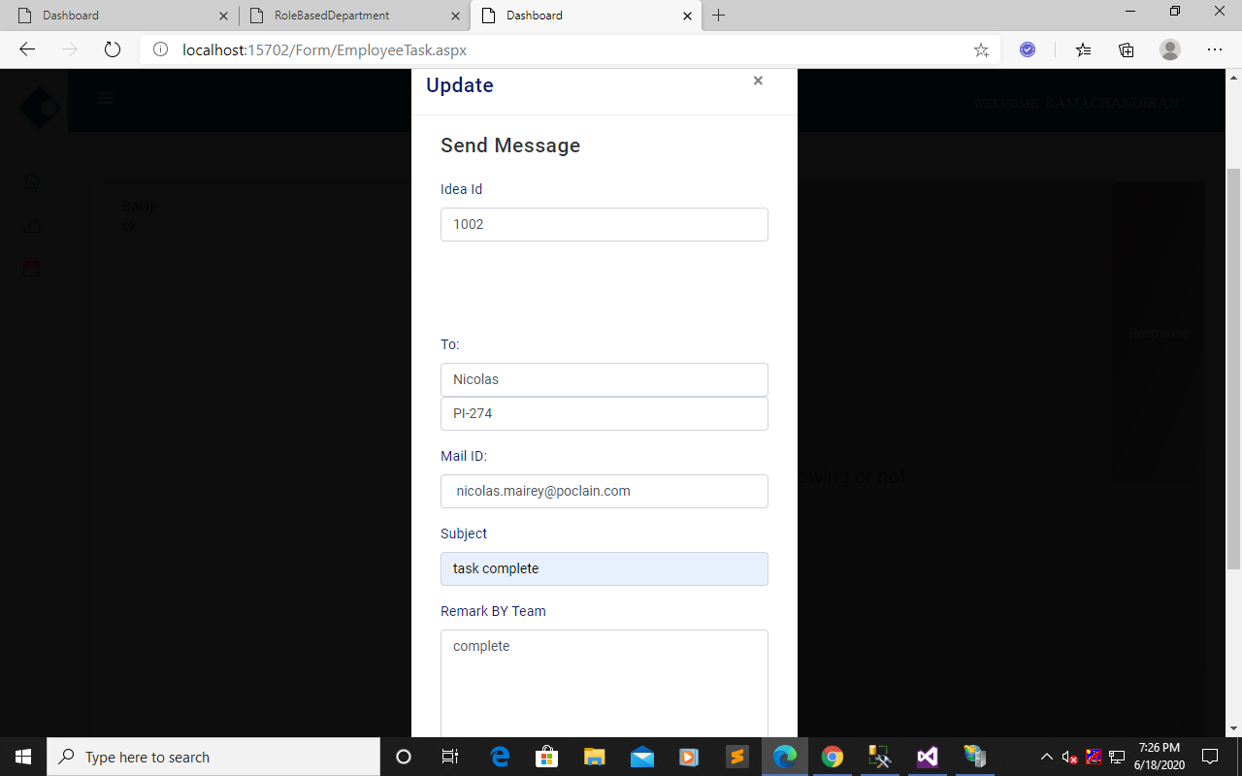
Update the Implement member to HOS.
PROCESS TO HOS

Slide 20
DATA BANK MANAGER

Slide 21
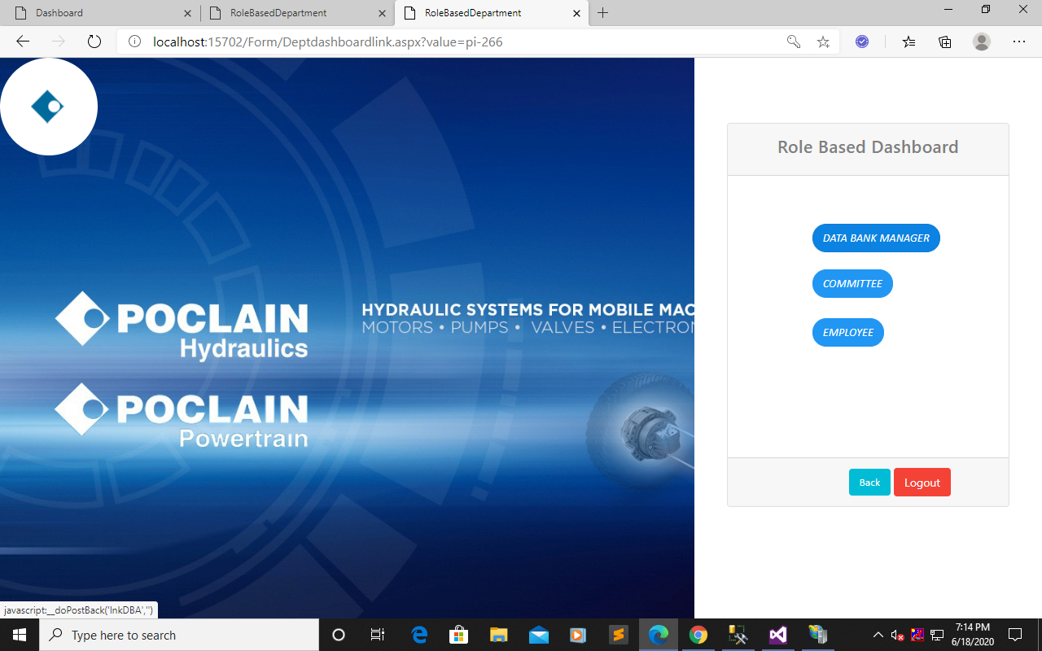
Role Based Login:
In this link page to represent official members link to its Role Based login.
ROLE ACCESS

Slide 22
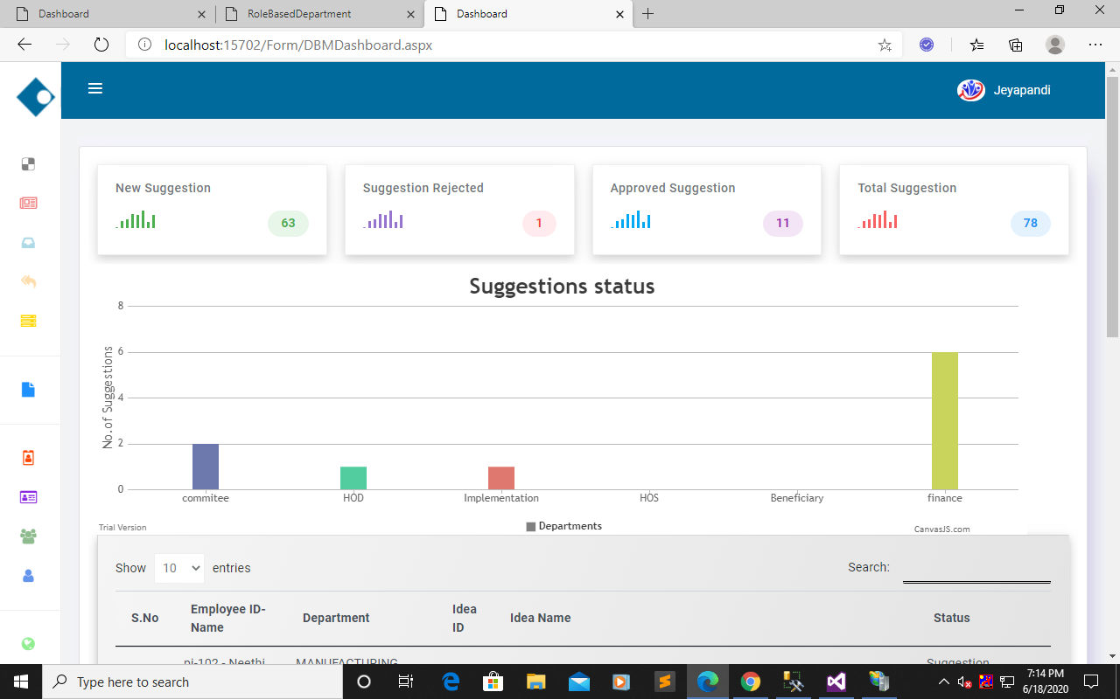
DBM module
In this module contain some of the responsibilities to details below here.
DBM Dashboard: To details of view depends on suggestion.
IDEA COUNT
BAR CHART
TABLE VIEW

Slide 23
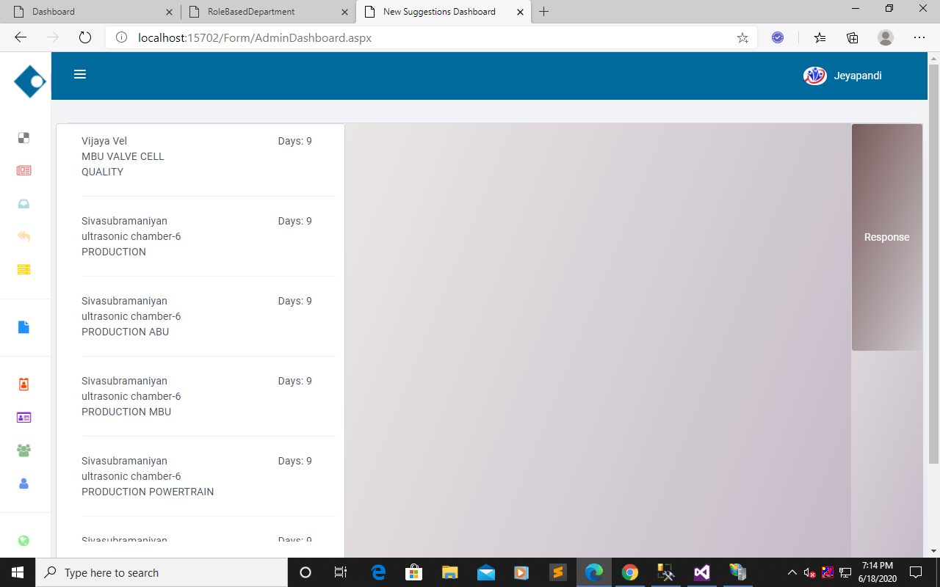
New Suggestion View: To view employee new suggestion.
CLICK
MAILBOX

Slide 24
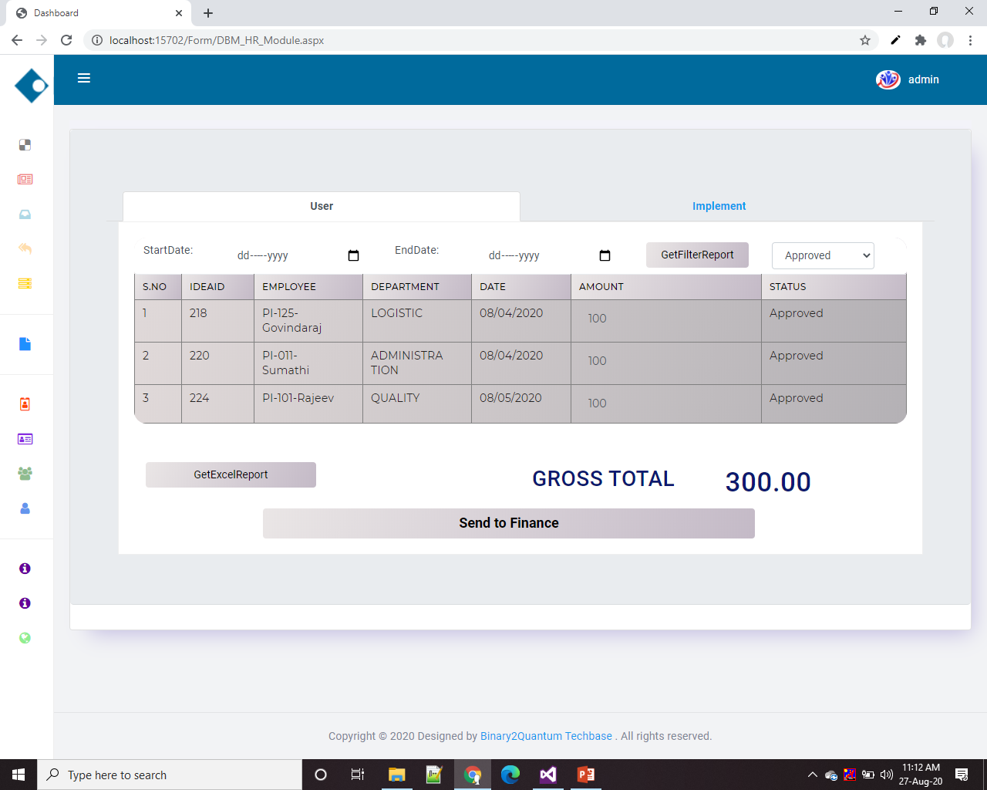
HR module:(Inbox)
In this module to represent Send to Finance Process .
Filter process
click

Slide 25
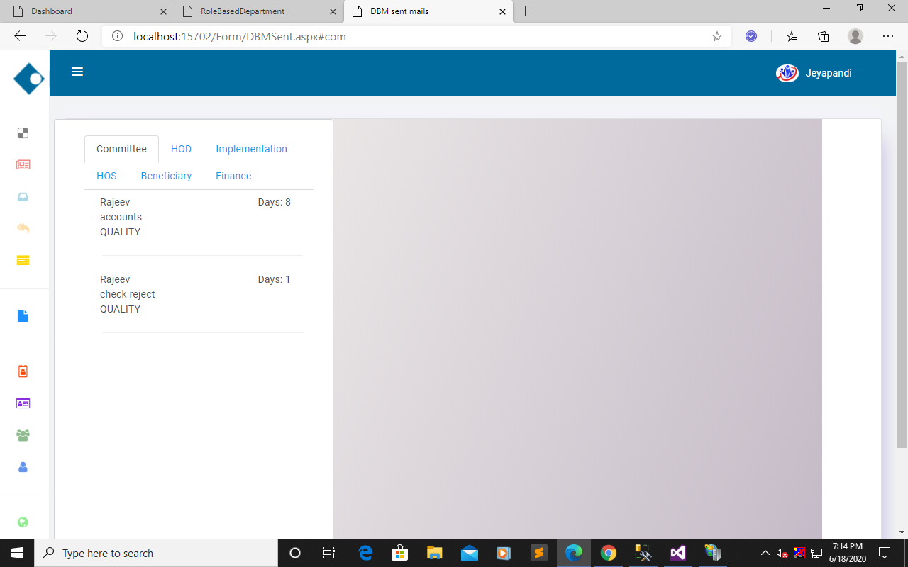
DBM Sent: To view suggestions depend on modules.
MAILBOX

Slide 26
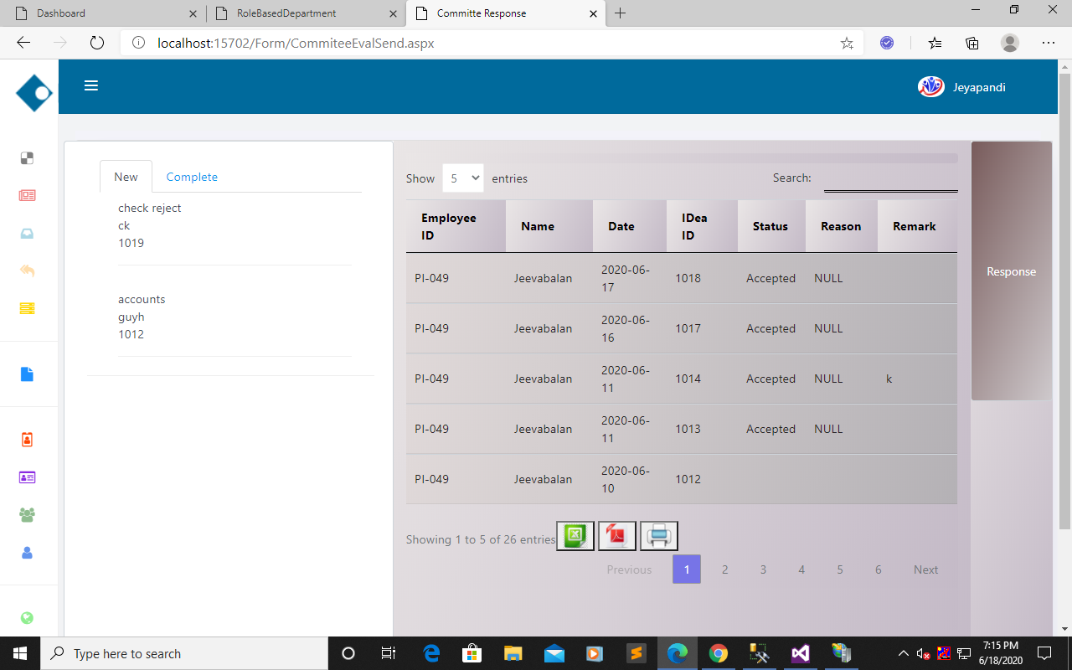
Committee Response: To view committee member response.
CLICK NEXT LEVEL
MAILBOX

Slide 27
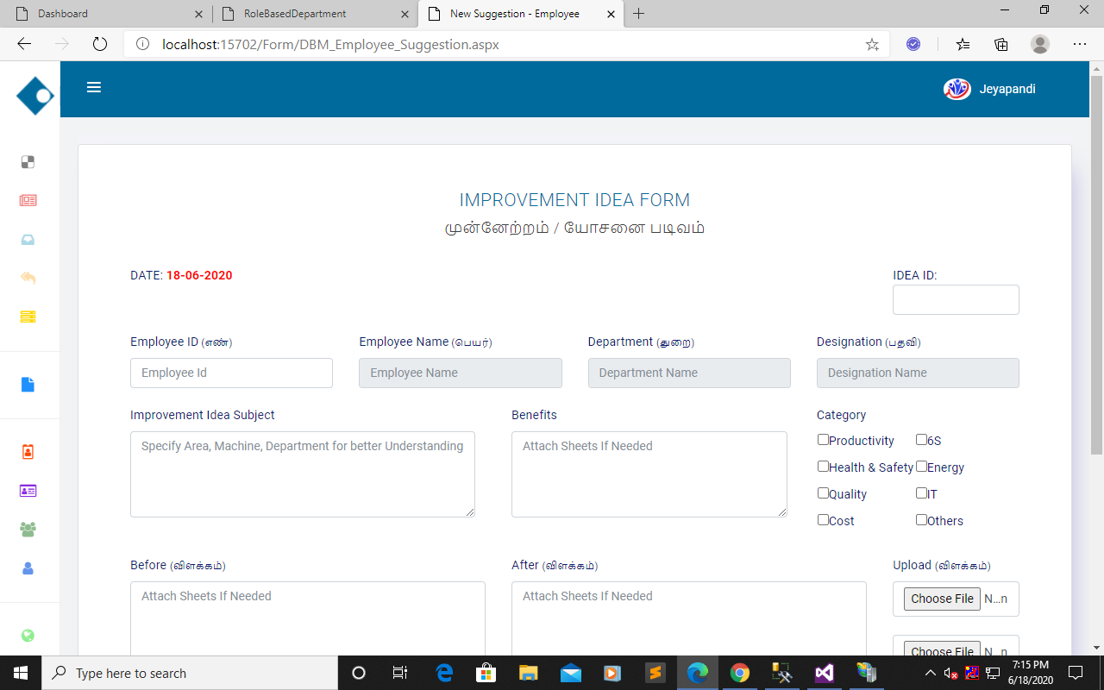
DBM_Employee_Suggestion: To view DBM will post employee suggestion.

Slide 28
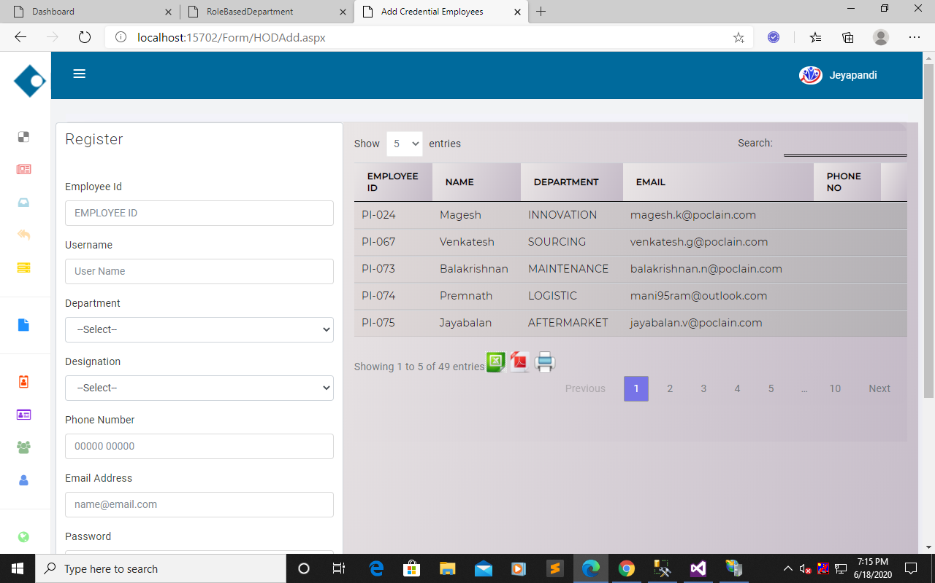
HOD_ADD: To view DBM will insert the official members.
ADD OFFICIAL PEOPLE

Slide 29
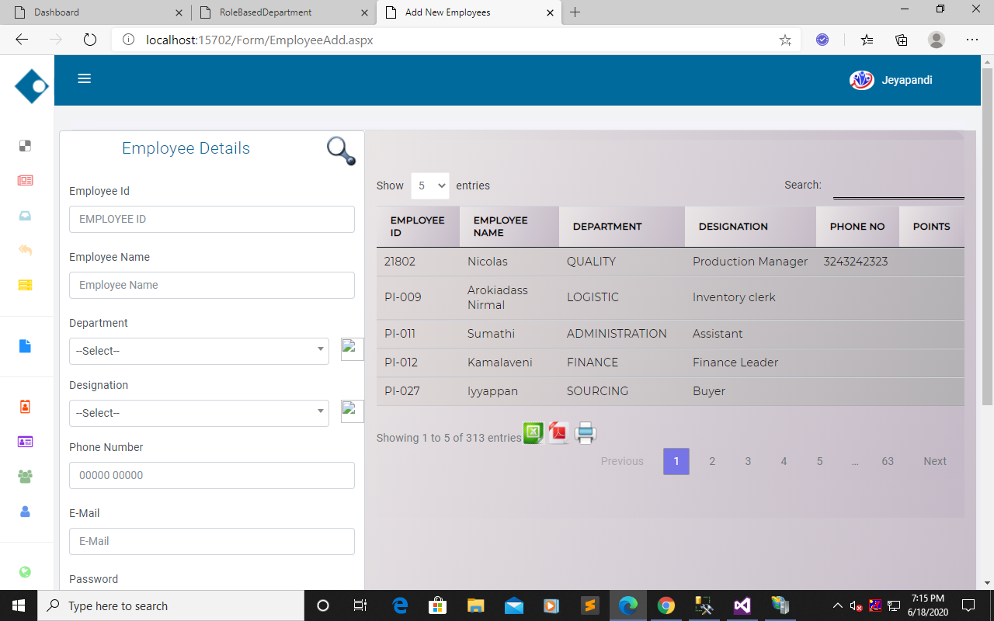
EMPLOYEE_ADD: To view DBM will insert the employees.
ADD EMPLOYEE

Slide 30
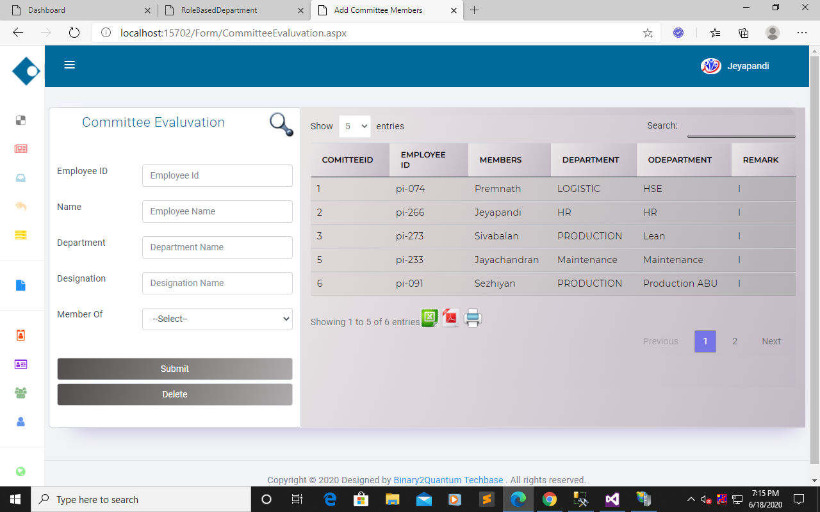
Committee Evaluation: To view DBM will add the committee members from official people.
ADD COMMITTEE PEOPLE

Slide 31
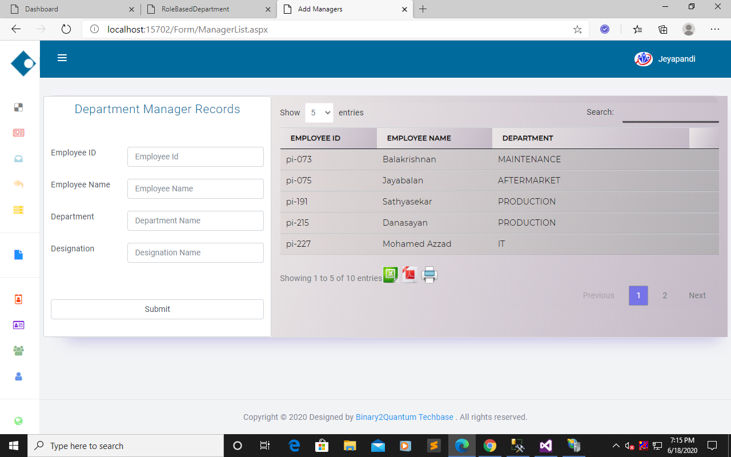
Manager List: To view DBM will add the HOD from official people.
ADD HOD

Slide 32
COMMITTEE

Slide 33
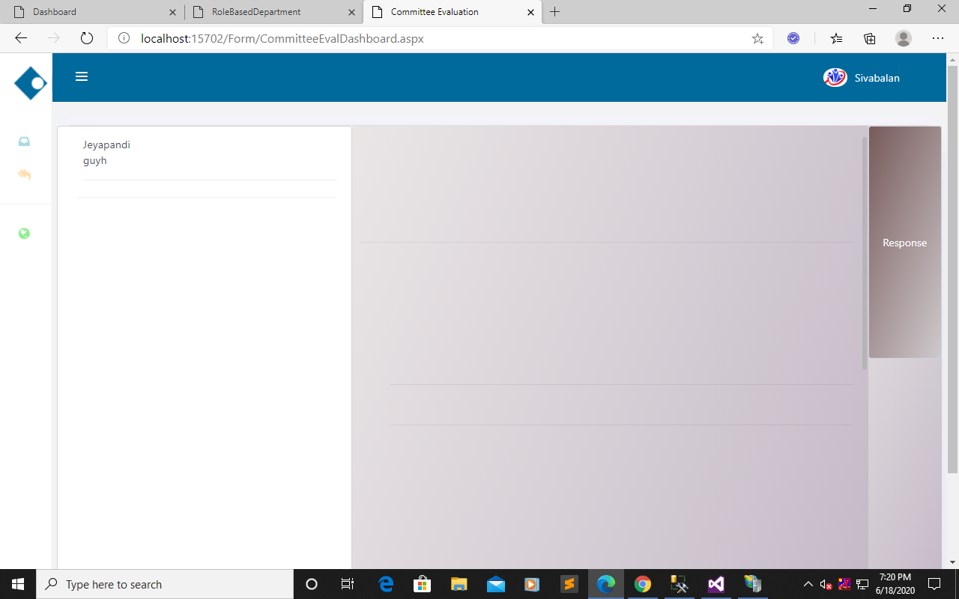
Committee module:
In this module represents committee members reply the suggestion Accepted or Rejected to DBM.
CLICK
MAILBOX

Slide 34
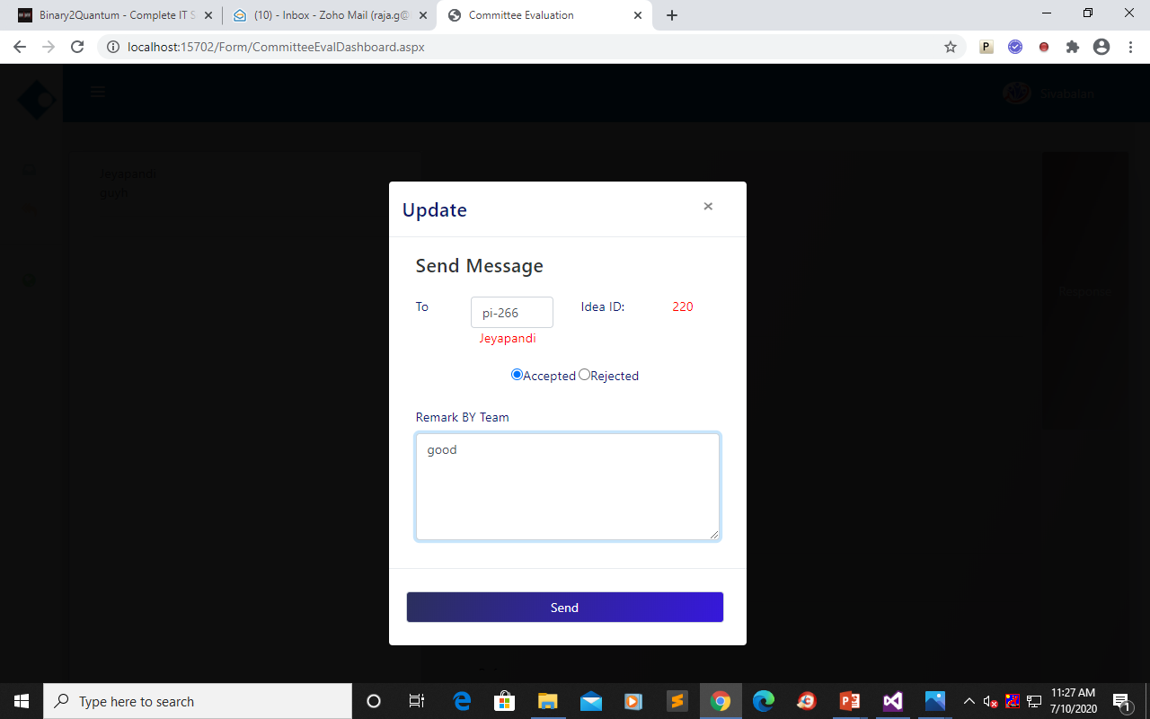
In its represent committee member to evaluate the suggestion accept or reject and send to DBM.
ACCEPT & REJECT PROCESS

Slide 35
HOd

Slide 36
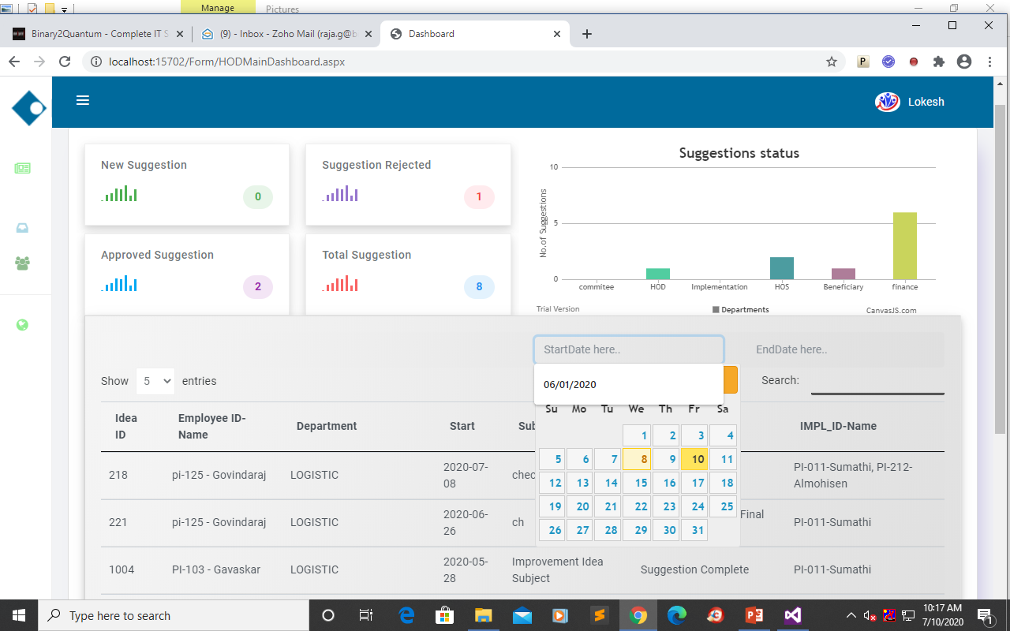
HOD module:
In this module represents, assign DBM to HOD with the purpose of idea execute with our own team member and other HOD help.
HOD Dashboard: To details of view depends on suggestion in particular Login HOD.
FILTER PROCESS

Slide 37
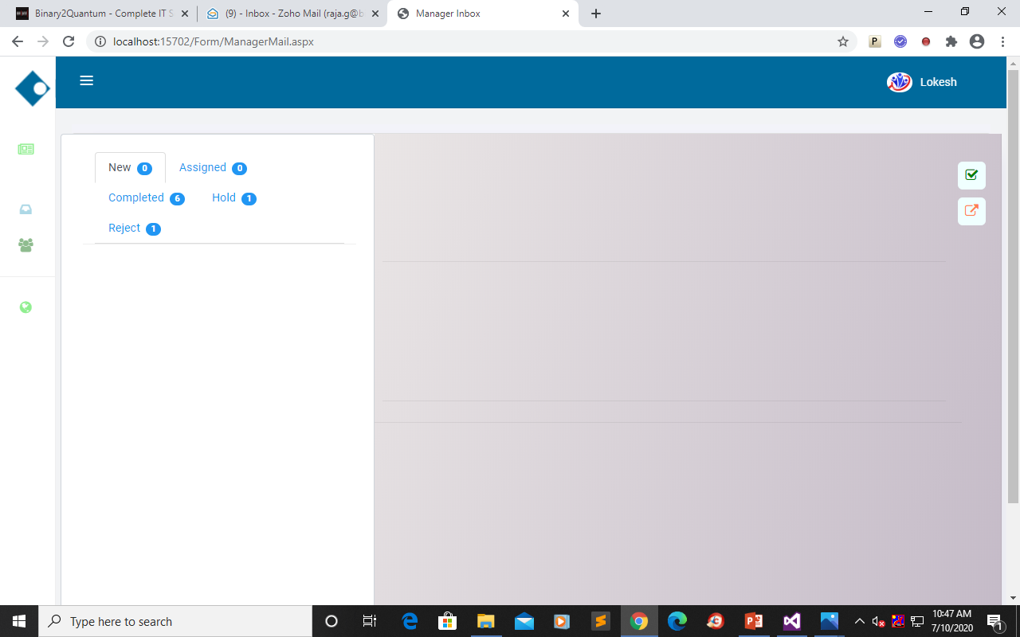
Manager Mail(Inbox): In this Inbox represent Hod Handle the suggestion for its tabs from DBM assign.
CLICK OWN TEAM
CLICK OTHER HOD
MAILBOX

Slide 38
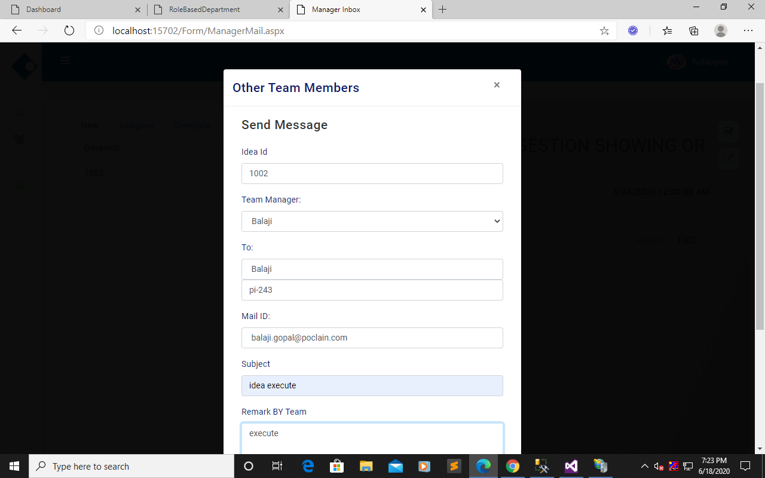
Other Team Members: To view HOD will send Other HOD
ASSIGN IDEA TO OTHER HOD PROCESS

Slide 39
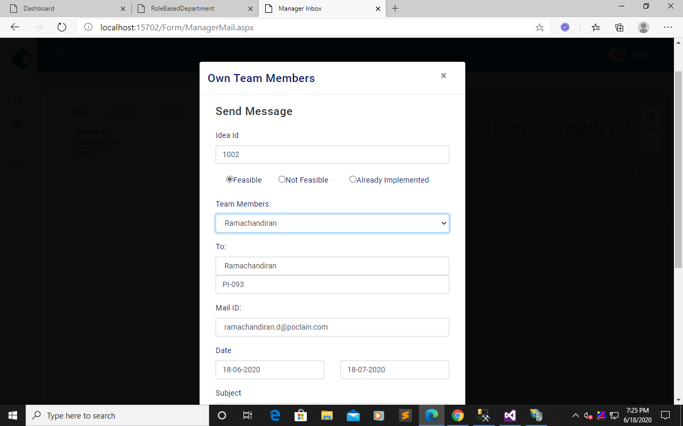
Own Team Members: To view HOD to assign Implement Team.
ASSIGN TASK PROCESS

Slide 40
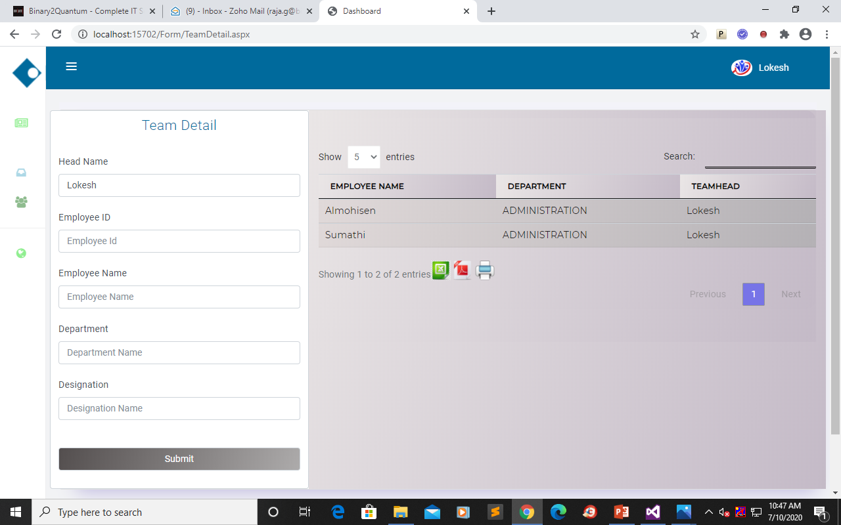
Team Detail: To insert team member in HOD
TEAM MEMBER INSERT PROCESS

Slide 41
HOs

Slide 42
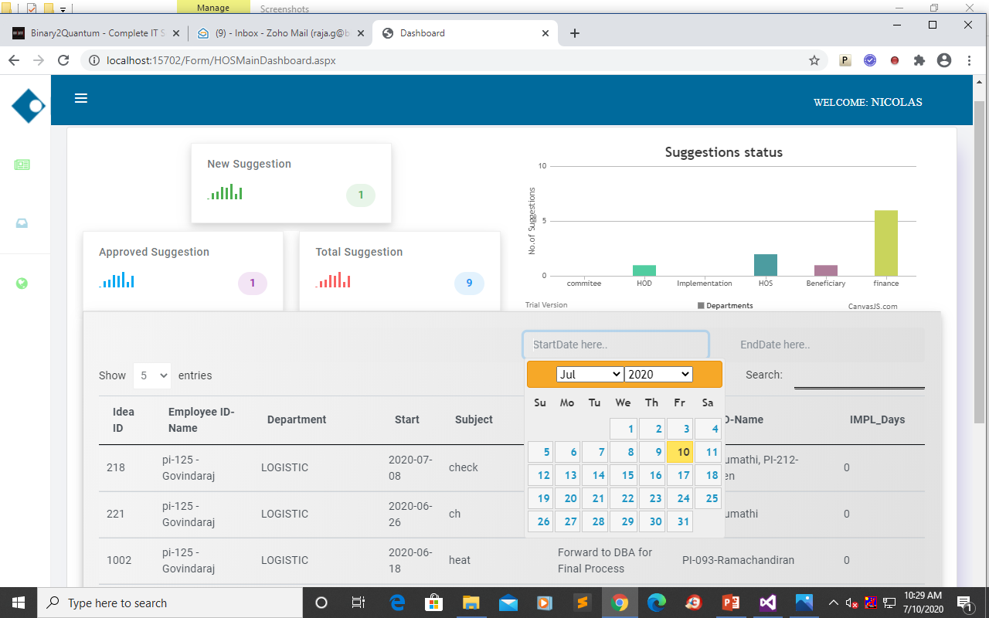
HOS module
In this module to represent after implement the suggestion will set the Score and Ratings.
HOS Dashboard: To details of view depends on suggestion in particular Login HOS.
FILTER PROCESS

Slide 43
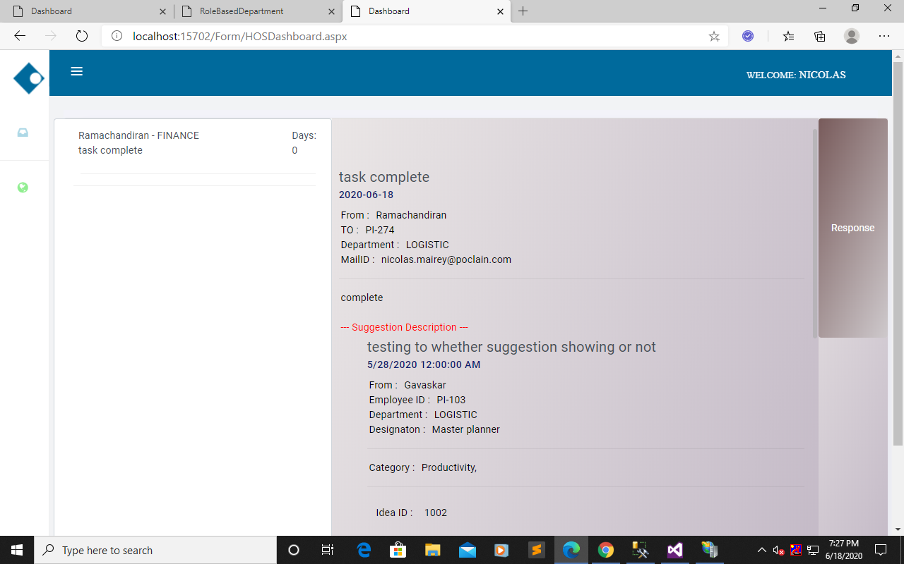
Inbox: To represent handle the suggestion for HOS
CLICK
MAILBOX

Slide 44
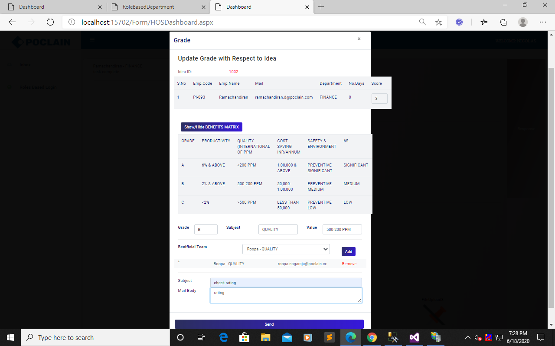
To view below HOS set the score and ratings and send beneficiary.
SET RATING & CLICK NEXT LEVEL

Slide 45
BENEFICIARY

Slide 46
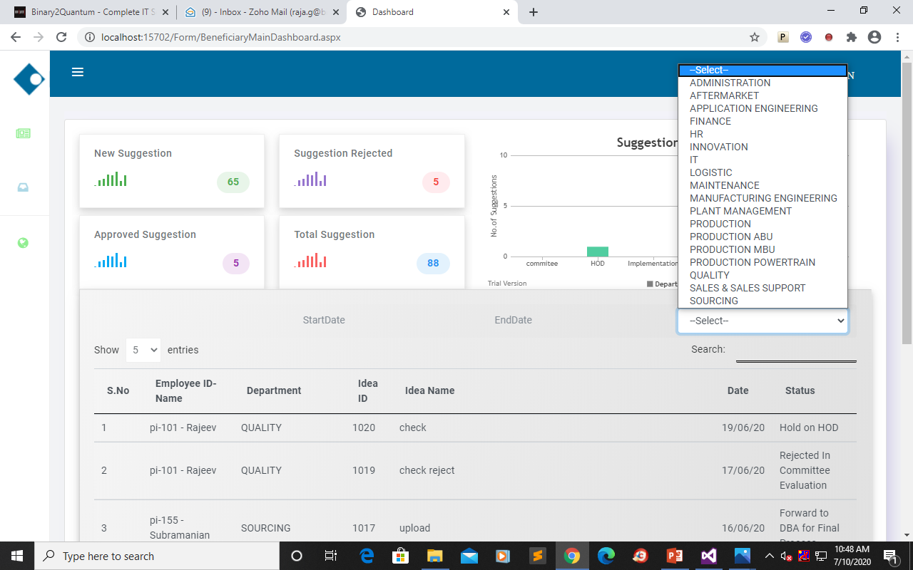
Beneficiary module:
In this module to represent check the score and ratings from HOS, same and change and send HR .
Beneficiary Dashboard: To details of view depends on suggestion and filter date and department.
FILTER PROCESS

Slide 47
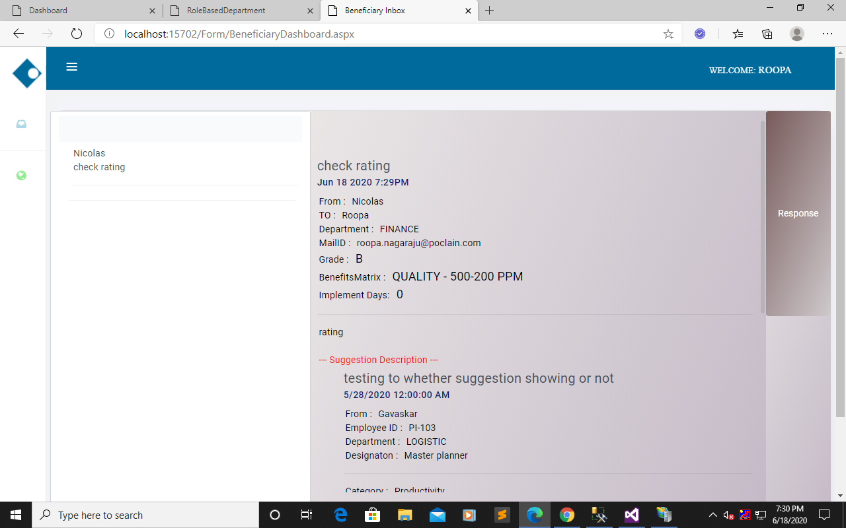
Inbox: In this Inbox represent Beneficiary Handle the suggestion from HOS.
CLICK
MAILBOX

Slide 48
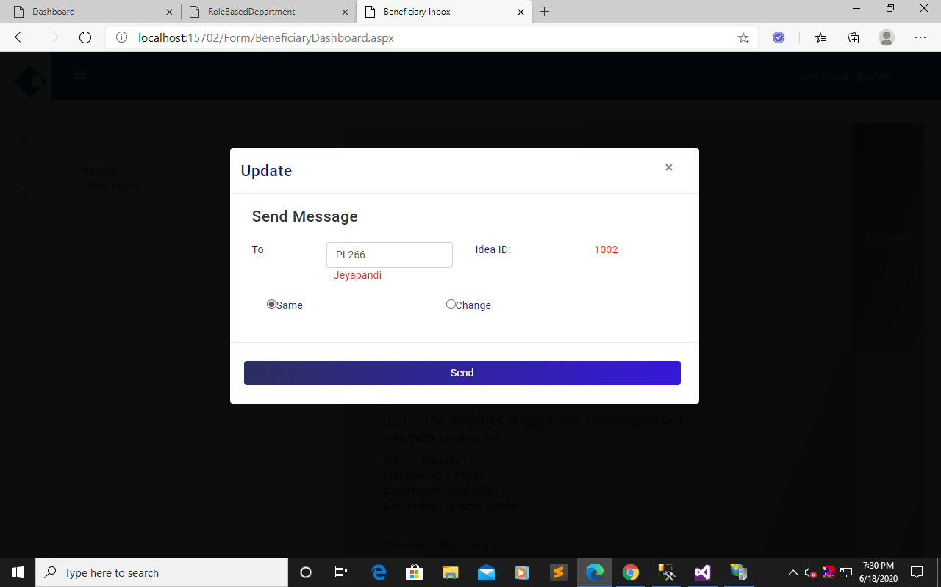
Same
SAME RATING
CLICK (HR LEVEL)

Slide 49
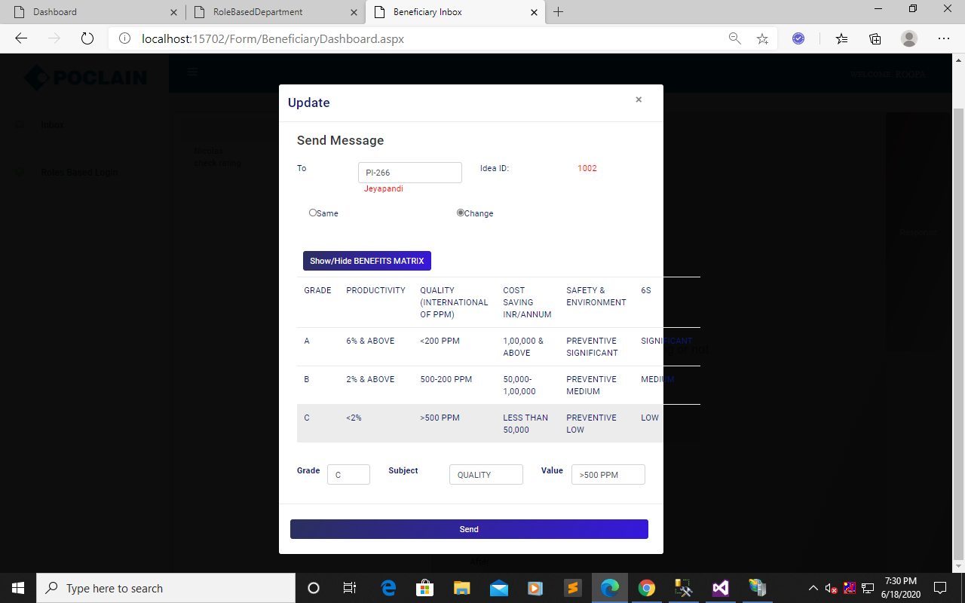
Change
CHANGE RATINGS

Slide 50
BENEFICIARy approval

Slide 51
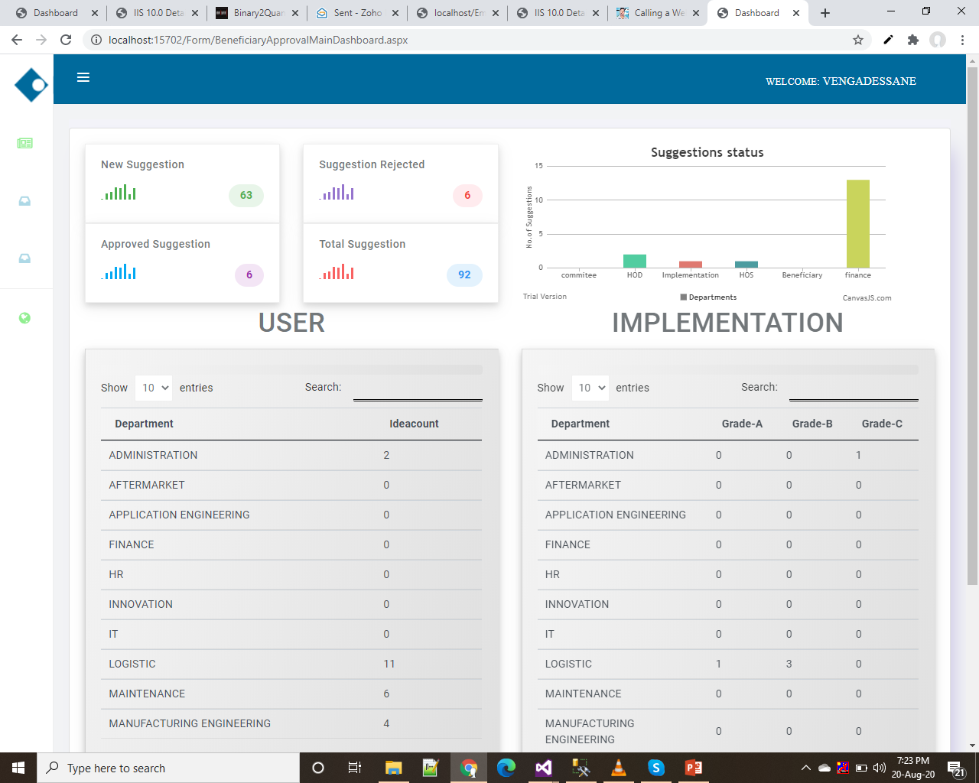
Beneficiary Approval module:
In this module to represent Approved from beneficiary send suggestions .
Beneficiary Approval Dashboard: To details of view depends on suggestion and filter date and get Excel report.
User
Implement

Slide 52
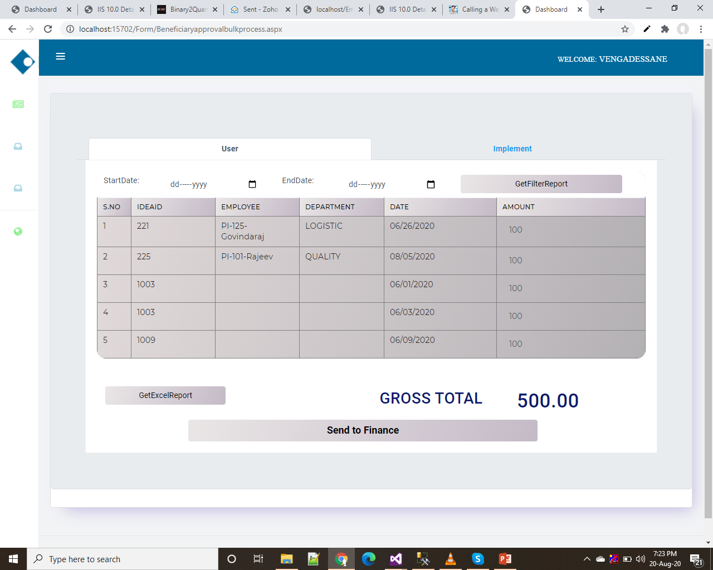
Bulk Process: In this represent Beneficiary Approval approved bulk suggestion using filter and get Excel report.
Filterprocess
CLICK

Slide 53
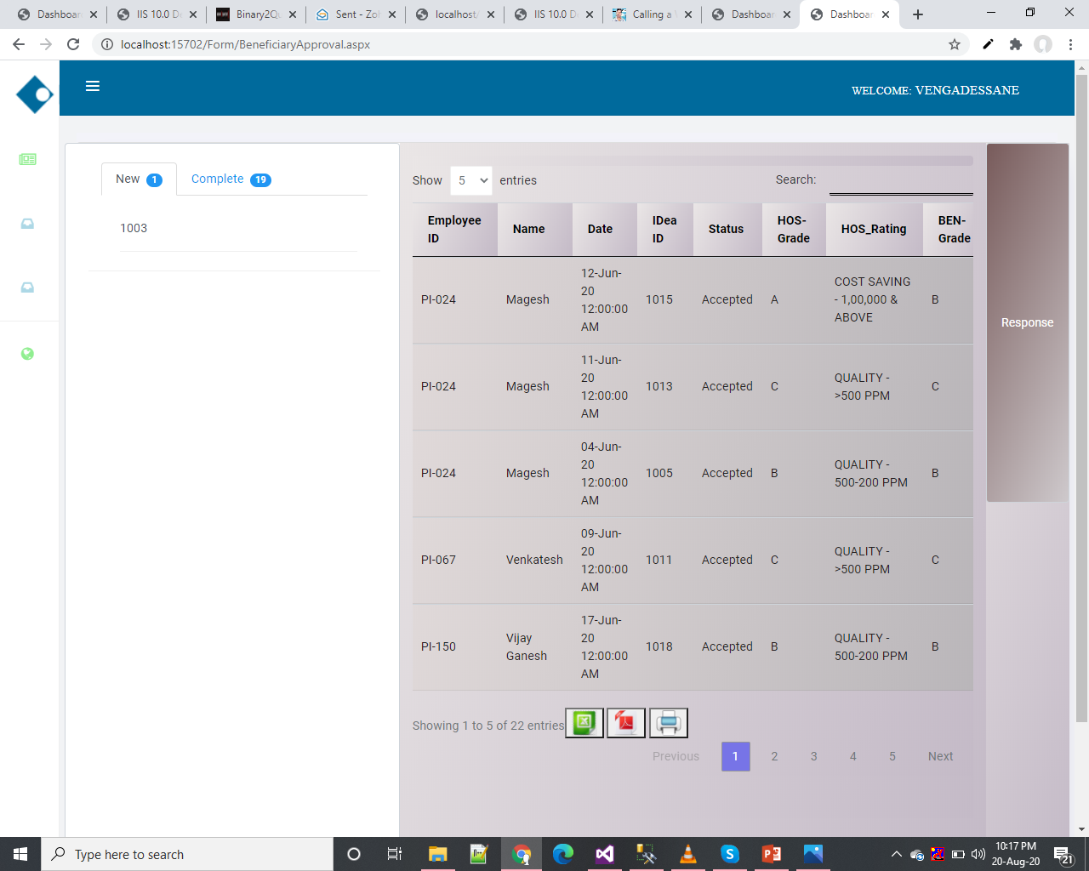
Inbox: In this represent Beneficiary Approval approved single suggestion.
CLICK
MAILBOX

Slide 54
FINANCE

Slide 55
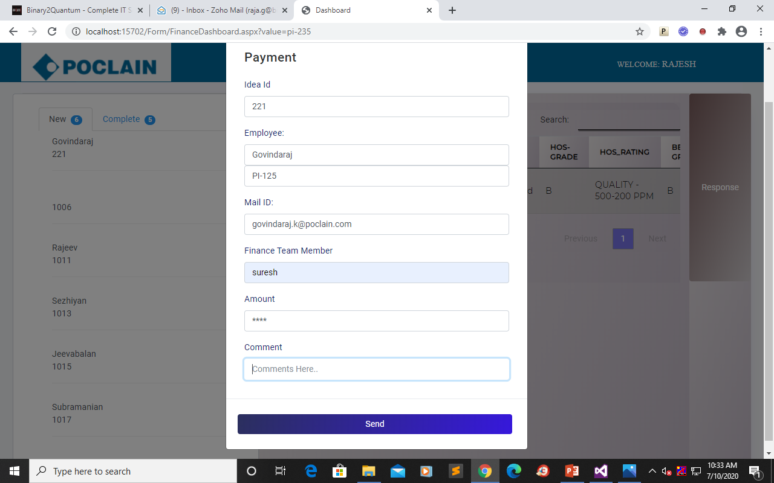
Finance module:
User Inbox: In this module to represent finally payment to particular idea person.
CLICK PAYMENT

Slide 56
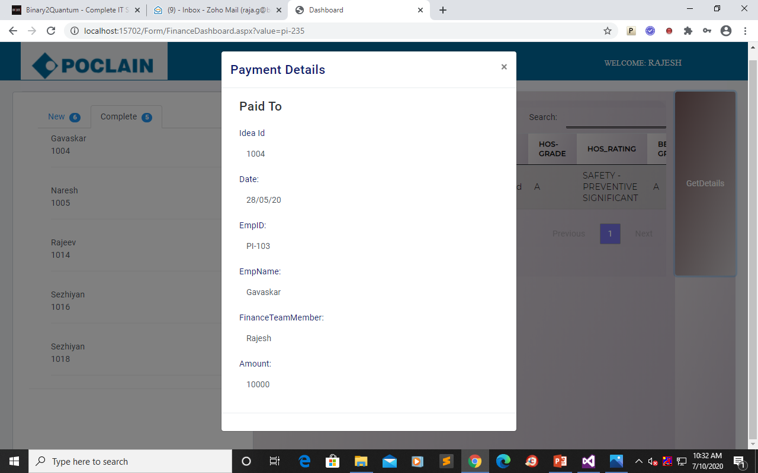
In its represent paid payment details to particular idea person.
PAID DETAILS

Slide 57
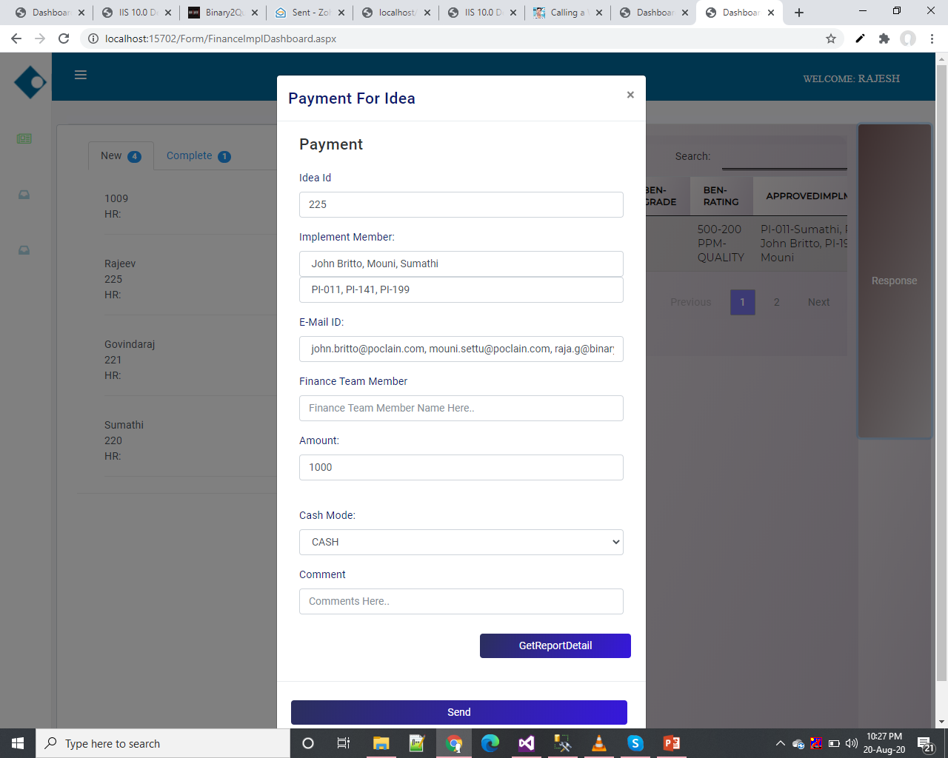
Implement Inbox:In this module to represent finally payment to particular idea Implement person.

Slide 58
Thank you

